Slide 1
NYPD Complaints and Crime Statistics
2018 04 01
Haihui Cao
Kenneth Chen
Benjamin Silk

Slide 2
24 features
5.6 million crimes

Slide 3
Kenneth’s approach
rows engineering
5.6 million crimes
after removing empty data (NaN in start and closed dates, city, crimes, lat and long)
4 million crimes
features engineering
24 features
deleted 2 features [‘PARKS_NM’, ‘HADEVELOPT’]
22 features remaining
NYPD columns
0 CMPLNT_NUM
1 CMPLNT_FR_DT
2 CMPLNT_FR_TM
3 CMPLNT_TO_DT
4 CMPLNT_TO_TM
5 RPT_DT
6 KY_CD
7 OFNS_DESC
8 PD_CD
9 PD_DESC
10 CRM_ATPT_CPTD_CD
11 LAW_CAT_CD
12 JURIS_DESC
13 BORO_NM
14 ADDR_PCT_CD
15 LOC_OF_OCCUR_DESC
16 PREM_TYP_DESC
17 X_COORD_CD
18 Y_COORD_CD
19 Latitude
20 Longitude
21 Lat_Lon

Slide 4
crime statistics over the years
number of complaints by year
2006.0 331754
2007.0 343727
2008.0 349474
2009.0 345874
2010.0 350686
2011.0 349737
2012.0 362387
2013.0 370114
2014.0 377513
2015.0 377502
2016.0 383539

Slide 5
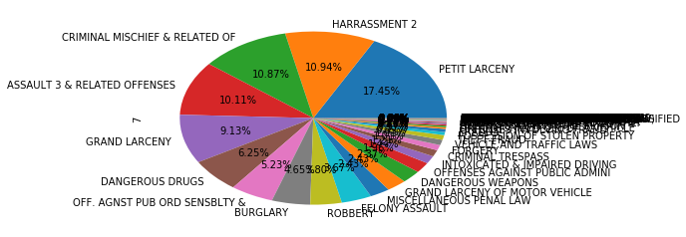
The most frequent crimes between 2006 – 2016
PETIT LARCENY 688005
HARRASSMENT 2 431275
CRIMINAL MISCHIEF & RELATED OF 428688
ASSAULT 3 & RELATED OFFENSES 398708
GRAND LARCENY 359811
DANGEROUS DRUGS 246411
OFF. AGNST PUB ORD SENSBLTY & 206066
BURGLARY 183337
ROBBERY 149707
FELONY ASSAULT 144699

Slide 6
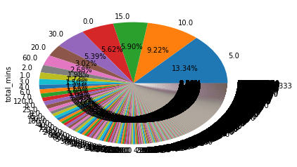
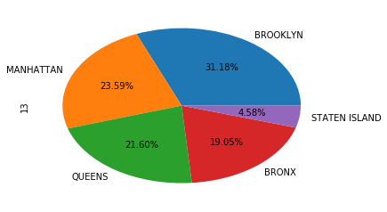
Total minutes taken
5.0 527289
10.0 364559
15.0 233072
0.0 222278
30.0 213119
20.0 119527
60.0 105768
2.0 78363
1.0 68354
3.0 59321
4.0 48384
6.0 44470
7.0 43223
120.0 41029
minutes
city
City
BROOKLYN 1233120
MANHATTAN 932681
QUEENS 854064
BRONX 753175
STATEN ISLAND 181219

Slide 7
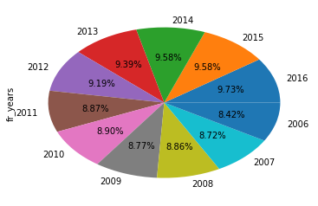
2016 383539
2015 377502
2014 377513
2013 370114
2012 362387
2011 349737
2010 350686
2009 345874
2008 349474
2007 343727
2006 331754
~ 11,000 cases were removed due to years mismatch and typo before 2006.
eg, 1906, 1956 was keyed in instead of 2006, and 1948 for 2008, so on and so forth

Slide 8
Taking the crimes statistics by year
Result, majority of crimes appear consistently in numbers.
Eg, ‘Dangerous drugs’ crimes appeared within the range of 18,000 to 26,000 whereas Fortune telling crimes only stood at within a single digit.

Slide 9
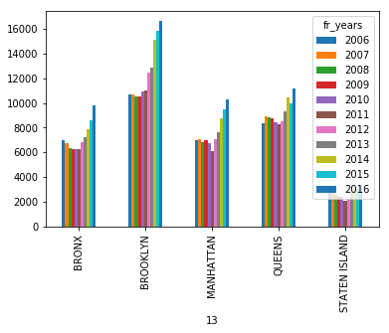
‘HARRASSMENT 2’ statistics by city from 2006 to 2016
BROOKLYN 137079
QUEENS 100964
MANHATTAN 84029
BRONX 79179
STATEN ISLAND 30024
‘HARRASSMENT 2’ crimes in each city with respective year

Slide 10
Crimes that takes 547 days to close
27435 BURGLARY
143061 HARRASSMENT 2
224522 OFF. AGNST PUB ORD SENSBLTY &
244856 THEFT-FRAUD
933785 GRAND LARCENY
1806860 GRAND LARCENY
1932161 HARRASSMENT 2
2027358 GRAND LARCENY
2334642 GRAND LARCENY
2635346 THEFT-FRAUD
2970653 GRAND LARCENY
3684636 OTHER OFFENSES RELATED TO THEF
3954257 OFF. AGNST PUB ORD SENSBLTY &

Slide 11
New York (Manhattan) Crimes that take more than 546 days to close

Slide 12
New York (Manhattan) Crimes that take more than 546 days to close

Slide 13
Haihui’s approach
Rows: 5580035
Columns: 24 columns
Column | Description
CMPLNT_NUM | Randomly generated persistent ID for each complaint
CMPLNT_FR_DT | Exact date of occurrence for the reported event (or starting date of occurrence, if CMPLNT_TO_DT exists)
CMPLNT_FR_TM | Exact time of occurrence for the reported event (or starting time of occurrence, if CMPLNT_TO_TM exists)
CMPLNT_TO_DT | Ending date of occurrence for the reported event, if exact time of occurrence is unknown
CMPLNT_TO_TM | Ending time of occurrence for the reported event, if exact time of occurrence is unknown
RPT_DT | Date event was reported to police
KY_CD | Three digit offense classification code
OFNS_DESC | Description of offense corresponding with key code
PD_CD | Three digit internal classification code (more granular than Key Code)
PD_DESC | Description of internal classification corresponding with PD code (more granular than Offense Description)
CRM_ATPT_CPTD_CD | Indicator of whether crime was successfully completed or attempted, but failed or was interrupted prematurely
LAW_CAT_CD | Level of offense: felony, misdemeanor, violation
JURIS_DESC | Jurisdiction responsible for incident. Either internal, like Police, Transit, and Housing; or external, like Correction, Port Authority, etc.
BORO_NM | The name of the borough in which the incident occurred
ADDR_PCT_CD | The precinct in which the incident occurred
LOC_OF_OCCUR_DESC | Specific location of occurrence in or around the premises; inside, opposite of, front of, rear of
PREM_TYP_DESC | Specific description of premises; grocery store, residence, street, etc.
PARKS_NM | Name of NYC park, playground or greenspace of occurrence, if applicable (state parks are not included)
HADEVELOPT | Name of NYCHA housing development of occurrence, if applicable
X_COORD_CD | X-coordinate for New York State Plane Coordinate System, Long Island Zone, NAD 83, units feet (FIPS 3104)
Y_COORD_CD | Y-coordinate for New York State Plane Coordinate System, Long Island Zone, NAD 83, units feet (FIPS 3104)
Latitude | Latitude coordinate for Global Coordinate System, WGS 1984, decimal degrees (EPSG 4326)
Longitude | Longitude coordinate for Global Coordinate System, WGS 1984, decimal degrees (EPSG 4326)

Slide 14
CRM_ATPT_CPTD_CD
ATTEMPTED 96159
COMPLETED 5483869
dtype: int64

Slide 15
BORO_NM
BRONX 1209647
BROOKLYN 1666903
MANHATTAN 1331760
QUEENS 1105621
STATEN ISLAND 265641
dtype: int64

Slide 16
Top 10 most frequent crimes:

Slide 17
Crimes counts over 2006-2016:
RPT_DT
2006 536263
2007 536261
2008 528317
2009 511293
2010 507730
2011 496945
2012 502701
2013 495662
2014 489825
2015 477394
2016 478752
Freq: A-DEC, Name: OFNS_DESC, dtype: int64

Slide 18
Crimes counts of each month over 2006-2016:

Slide 19
Haihui’s approach

Slide 20
Benjamin’s approach

